Slide 1

Ecocem Room, Level 2
Data Management & Electronic Health in EM
Friday 29th June , 10:00 – 12:00
Tony Shannon (UK)
Guideline Based, Workflow-Integrated
Electronic Health Records in EM

Slide 2
Tony Shannon
M.B. B.Ch. B.A.O. Ireland
Fellow of College of Emergency Medicine England
Fellowship in Informatics USA
MSc in IT Management England
Consultant in Emergency Medicine, Leeds Teaching Hospitals
Chief Clinical Information Officer, Leeds Teaching Hospitals
(Clinical Lead, NHS Connecting for Health – National Programme for IT)
(Chair, Clinical Review Board, openEHR Foundation)
Notes:
2

Slide 3


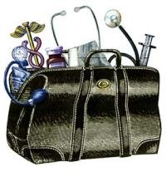
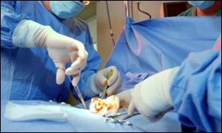


Slide 4
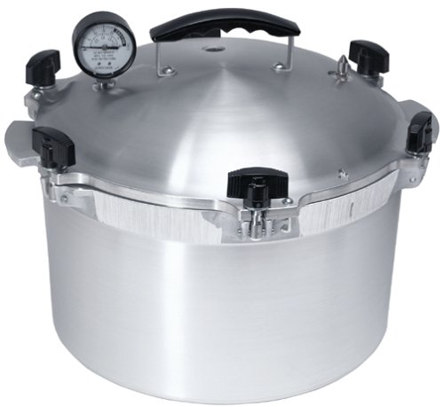





Slide 5
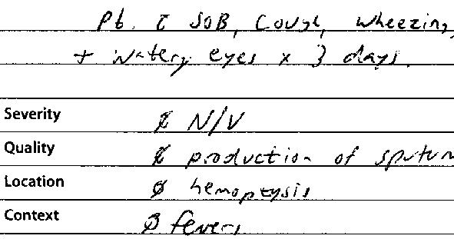


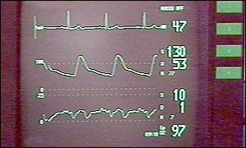
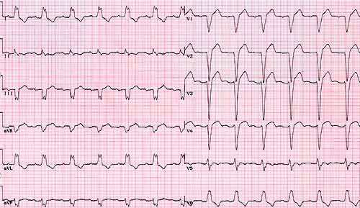
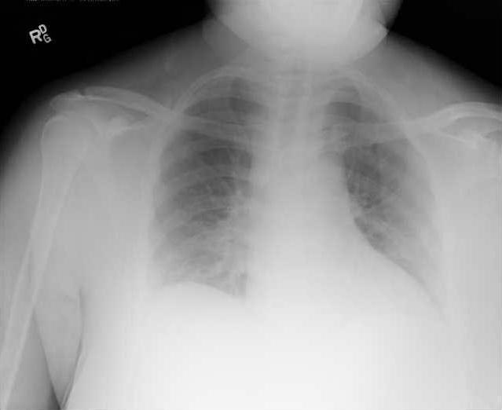
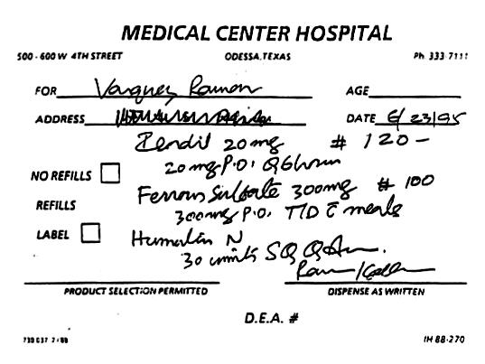
Notes:
Ladies and Gentlemen, Medicine is a tough business at times.
Part of what makes it so tough is the fact that every day and every hour of every day , every patient encounter involves dealing with a LOT of information.
Most doctors are very good at multitasking and processing information but there are many times when the volume of information we are trying to deal with can be overwhelming and can make it very hard to get to the right information at the right place and the right time

Slide 6
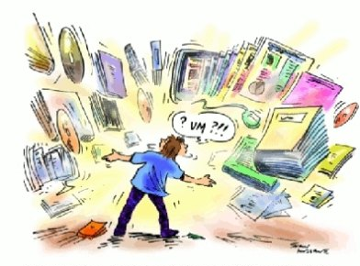

Slide 7





Key Elements of Emergency Medicine
Research (++ patients)
Doing the Right Thing
Doing Things Right
Right Care, Right Place, Right Time
Audit ( > 1 patient)
Frontline (1 patient)
Referral in
Assessment
Diagnostics
Deliver Care
Plan Care
Sorting
Referral Out

Slide 8


Bridging the Gap

Slide 9



Guideline Based Workflow Integrated EHRs
Notes:
We begin by introducing the project..
This project is really about business change…..
Change is one of the few constants in life
To effect change in business we can change people, processes or technology- of note IT is seen as a key enabler of business change
Indeed the SE discipline looks at this interface between business and IT and uses analysis, design, build and test stages to try to ensure the BP is supported by the IT
The Health care sector is under as much pressure to change as any and the role of IT to facilitate this change has been highlighted with the advent of the NPFiT
Within the NPfIT a new concept for the NHS called the Model Community aims to explore this interface between the HC Business and the new IT service
So when I was asked to take on this work 2 key questions came to mind…
1 How rigorous is the BP requirements analysis stage of this programme which leads up to the MC
2 How rigorous is the BP/IT testing stage- how does it deal with related “incidents”?

Slide 10


An Informatics Journey....
International Standards
National eHealth Bodies
& Vendors
Regional
Local Frontline Innovators
Notes:
10

Slide 11
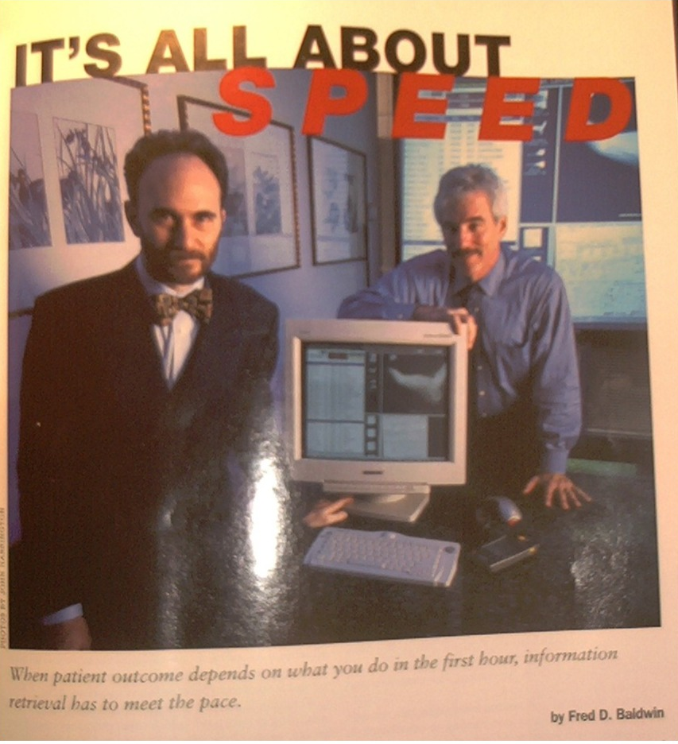

Slide 12
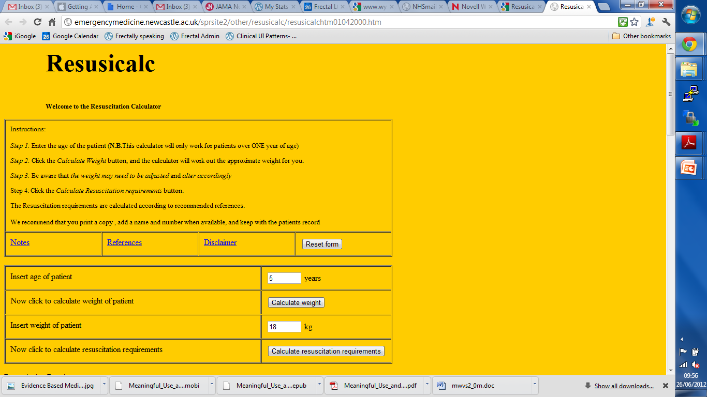
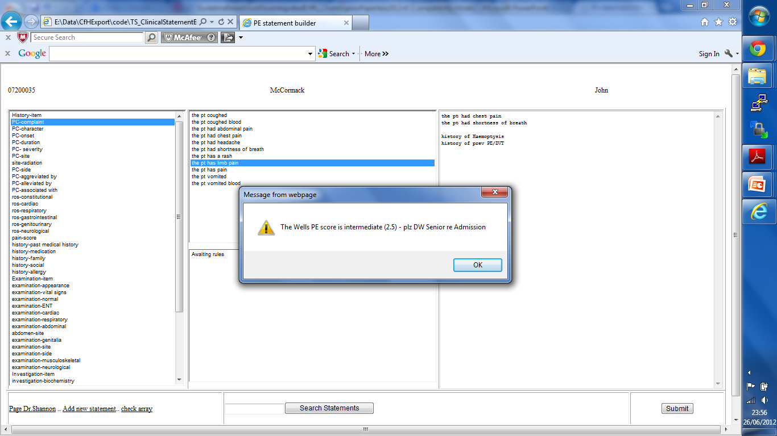
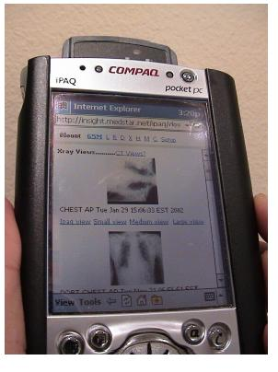
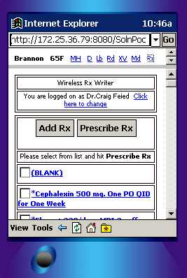

Slide 13


Info Tech..
Success not widespread….

Slide 14
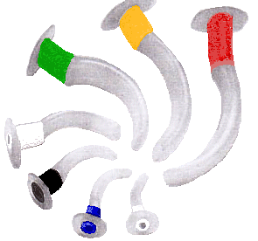

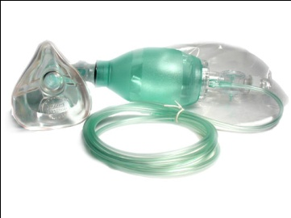

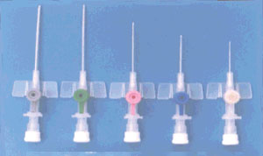

Emergency Medicine= Complex
Notes:
Ladies and Gentlemen, Medicine is a tough business at times.
Part of what makes it so tough is the fact that every day and every hour of every day , every patient encounter involves dealing with a LOT of information.
Most doctors are very good at multitasking and processing information but there are many times when the volume of information we are trying to deal with can be overwhelming and can make it very hard to get to the right information at the right place and the right time

Slide 15
Emergency Medicine =Complex
Vomiting; RR 25, HR 110, GCS 13/15, pH 7.2, Glu 35
  Whats the protocol say I should use
Mixed overdose (inc Paracetamol) staggered; over 7 hours ago; INR 4.5
  What should I treat with at this stage?
Diabetic + Collapse + Head Injury
  Which Guideline/Care Pathway Applies?

Slide 16

Complex Systems
Many parts, Many interactions
Perpetual novelty
Difficult to describe/understand completely
Difficult to control/change
Identify simple rules & patterns
  Self-organise
e.g. Weather, Economy, Internet, EM

Slide 17
...Informatics Journey.. cont...
International Standards
National eHealth Bodies
& Vendors
Regional
Local Frontline Innovators
Notes:
17

Slide 18



NHS: Connecting for Health
Biggest civil IT programme in world
Based in Leeds
Began in 2003
10 year; £12 billion;
Primary, Community, Acute, Mental Health
Aimed at few strategic solutions

Slide 19




Notes:
We begin by introducing the project..
This project is really about business change…..
Change is one of the few constants in life
To effect change in business we can change people, processes or technology- of note IT is seen as a key enabler of business change
Indeed the SE discipline looks at this interface between business and IT and uses analysis, design, build and test stages to try to ensure the BP is supported by the IT
The Health care sector is under as much pressure to change as any and the role of IT to facilitate this change has been highlighted with the advent of the NPFiT
Within the NPfIT a new concept for the NHS called the Model Community aims to explore this interface between the HC Business and the new IT service
So when I was asked to take on this work 2 key questions came to mind…
1 How rigorous is the BP requirements analysis stage of this programme which leads up to the MC
2 How rigorous is the BP/IT testing stage- how does it deal with related “incidents”?

Slide 20

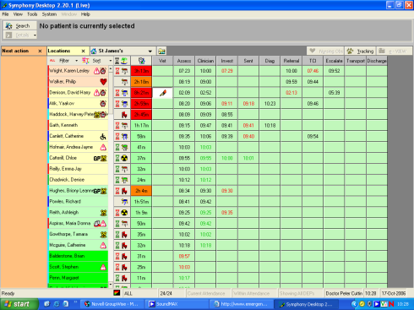

NHS EDs – after 4 hour standard

Slide 21

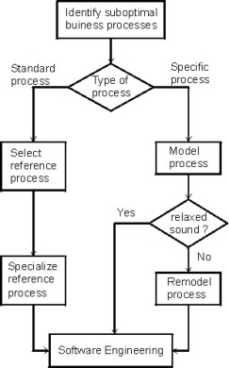
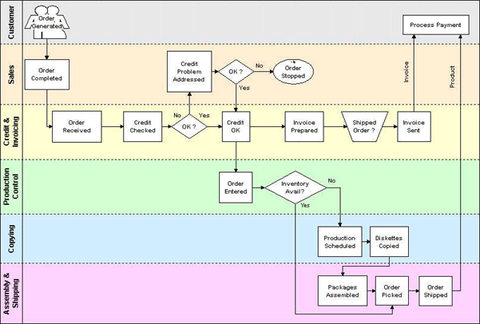

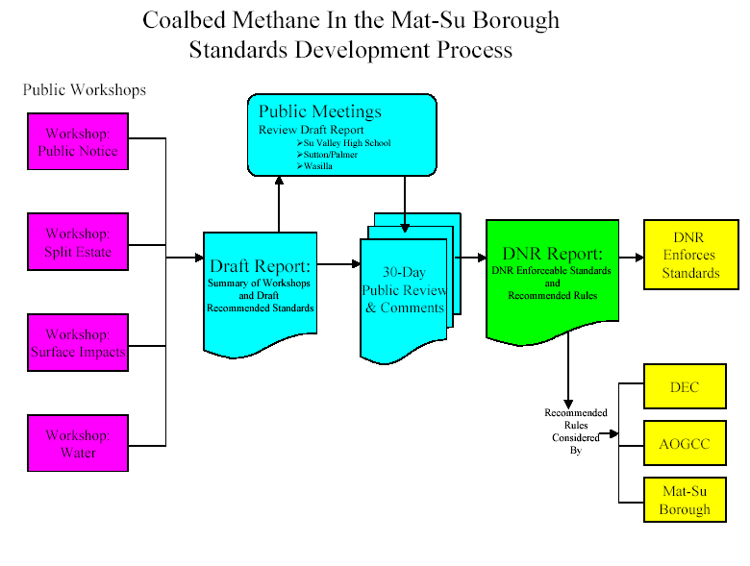
People + Process + Technology
?
Thinking in silos Clash between process and IT
Notes:
When we examine the literature on business change my view is that 3 common elements exist within any business,
The people, the processes, the technology
OF these the BP is the key focus when managing change
Of note it is well established that BP change should be supported by IT

Slide 23
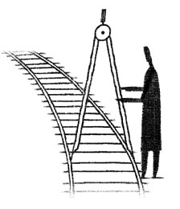
The need for Standards
  Clinical Information Technology

Slide 24

Guidelines + Health Records
Who
What
Why
When
Where
Care Pathways

Slide 25

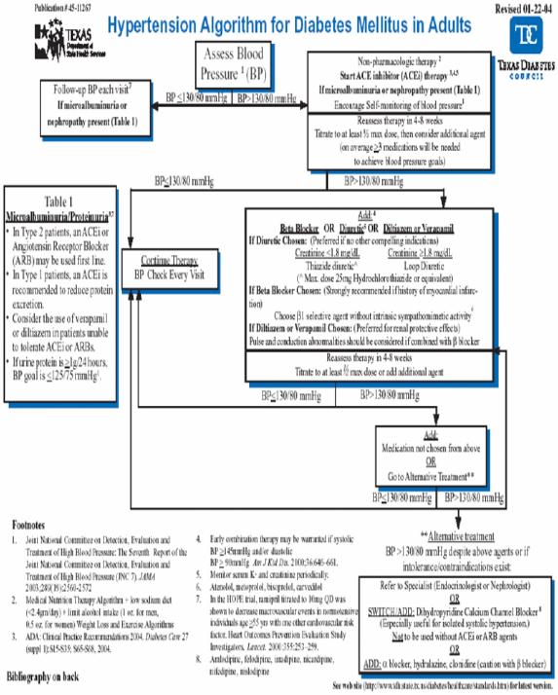
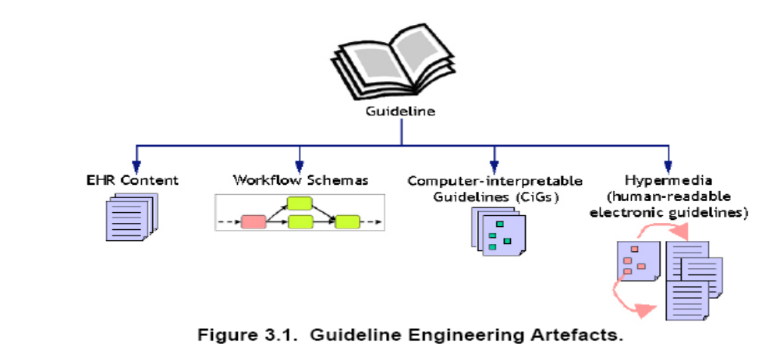
WHAT WHO WHEN WHY

Slide 26
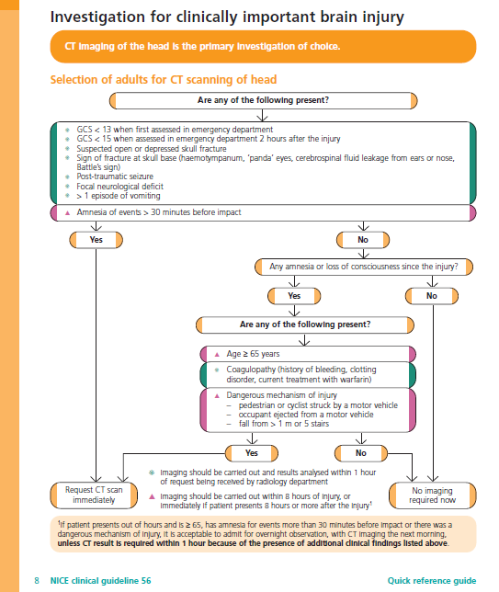
WHY, WHO, WHAT,WHEN: Human Guideline

Slide 27
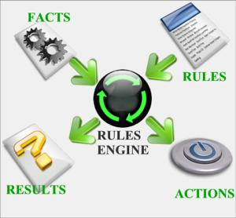
WHO, WHAT, WHEN : Computer Guideline
If
..
Else If..
Else If..
..
Else
..
End

Slide 28
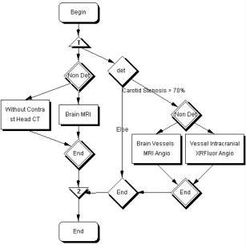
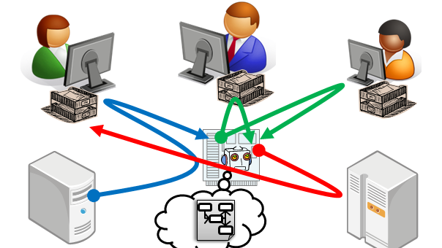

WHO & WHEN: Workflow

Slide 29
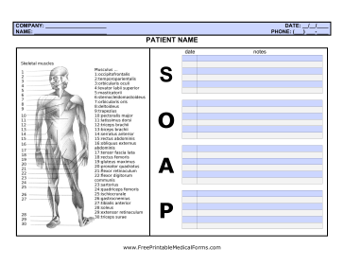
WHAT: Clinical Content

Slide 30
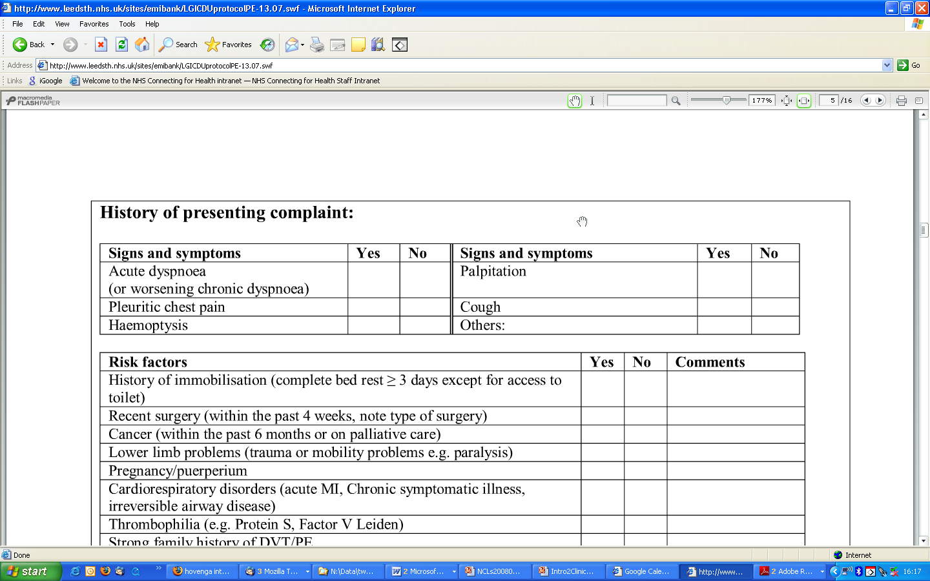
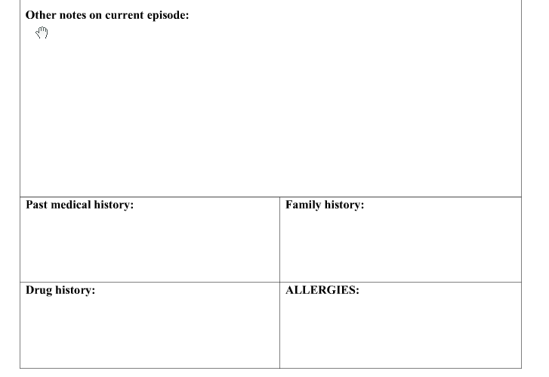
Clinical Content: Variation
Pulmonary Embolism template
Chest Pain template
Time of onset of index episode:……………………….. Duration:…… .hours /minutes Onset: Sudden / gradual Severity: Mild / Moderate / Severe / Unbearable Site of chest pain: Central / Left sided /Right sided / Generalised Character: Crushing / Burning / Sharp / Aching / Tight / Heavy / Tearing Other………………………….. | Radiation Left arm Right arm Both arms Neck /Jaw Back Abdomen Other…………….. Associated symptoms: Nausea Vomiting Sweating Belching | Aggravating factors None Exertion Breathing Coughing Movement Pressure Position Other………………. Relieving factors: None GTN

Slide 31
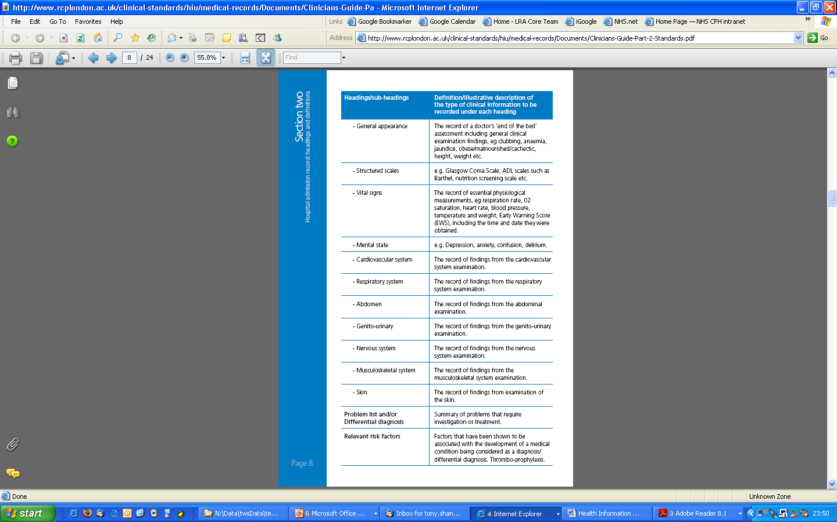
NHS Medical Record Standards
Clinically Led
  Royal Colleges
Record Headings
  Admission
  Handover
  Discharge
Quality Driven
Safety Driven

Slide 32

NHS Clinical Content Service
Generic Medical Documentation
  Admisson
  Handover
  Discharge
Emergency Medicine (Top 10)

Slide 33
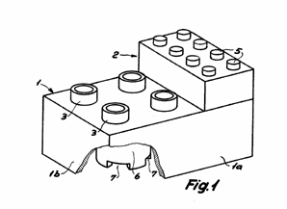

openEHR Foundation
International Non-Profit Foundation
Knowledge Oriented
Health Computing Platform
Tools & Specification
  Electronic Health Record

Slide 34

Focus on a Few...

Slide 35
Key Elements of Emergency Medicine
Research (++ patients)
Doing the Right Thing
Doing Things Right
Right Care, Right Place, Right Time
Audit ( > 1 patient)
Frontline (1 patient)
Referral in
Assessment
Diagnostics
Deliver Care
Plan Care
Sorting
Referral Out

Slide 36
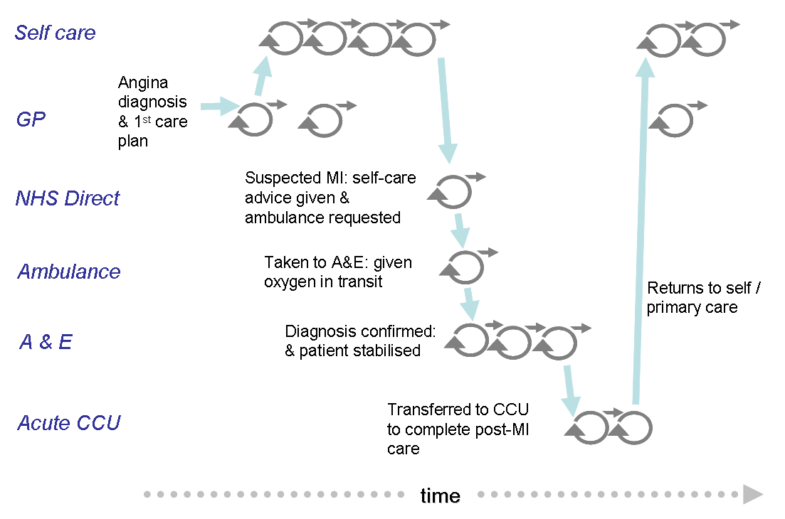
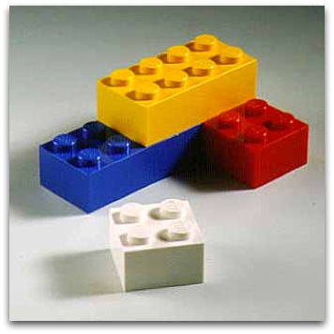


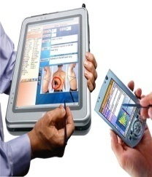

Clinical Content: Standards
Templates (Toys)‏
Specific
Generic Generic Process
Archetypes (Bricks)
Notes:
36

Slide 37
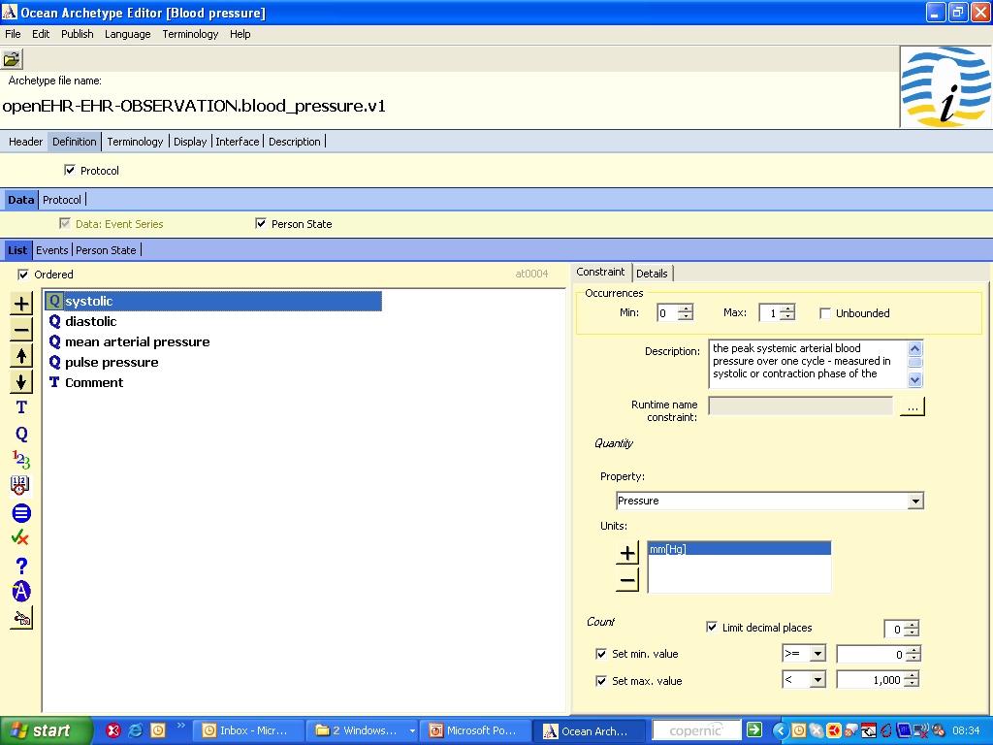
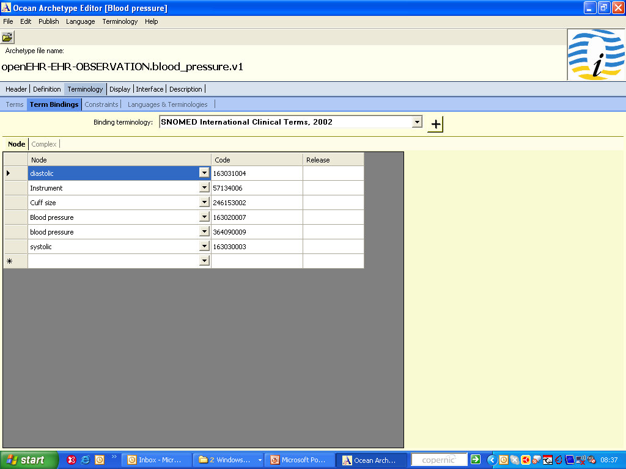
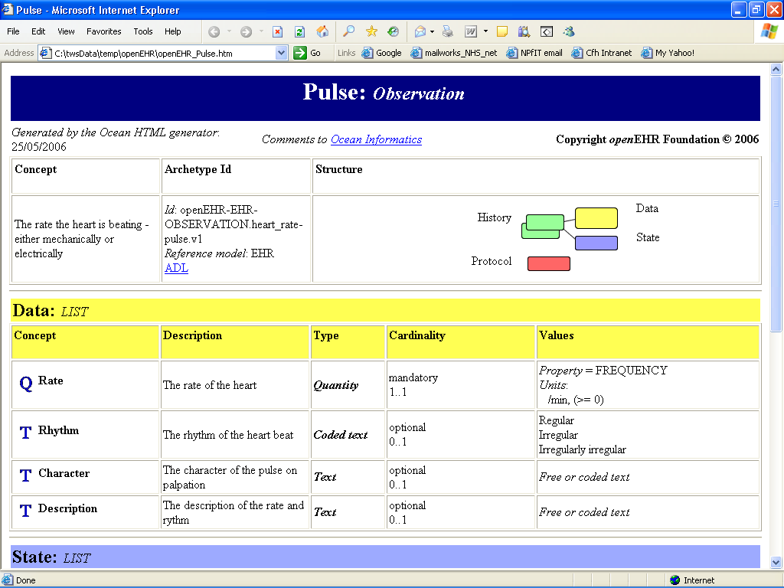
WHAT: Archetype
Reusable list of clinical statements
Maximal dataset
e.g. Pulse, BP

Slide 38
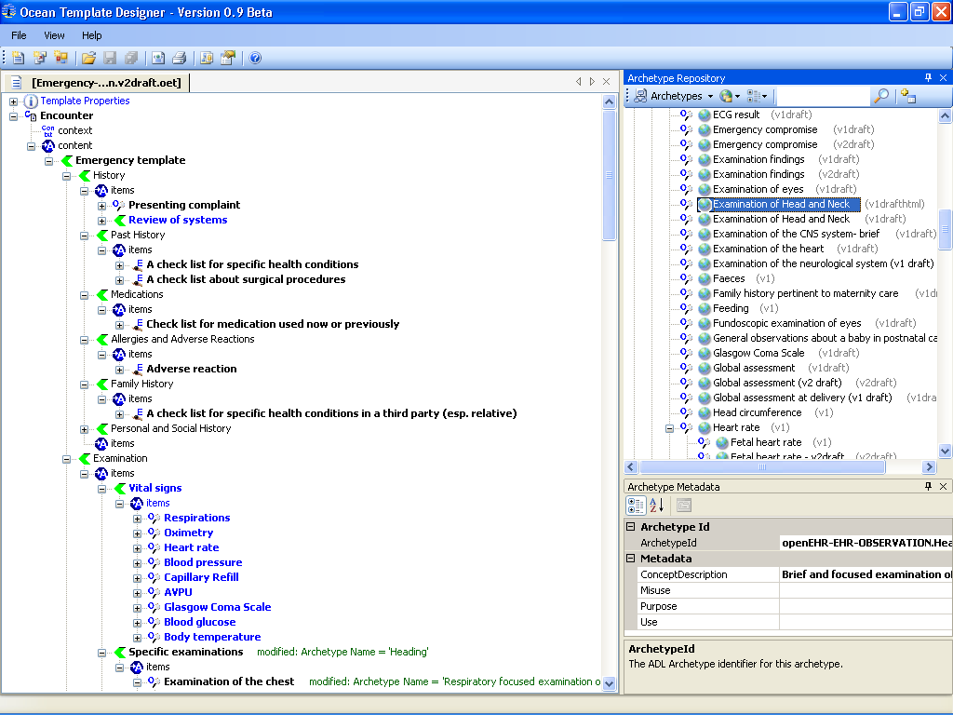
WHAT: Archetypes in Templates..

Slide 39
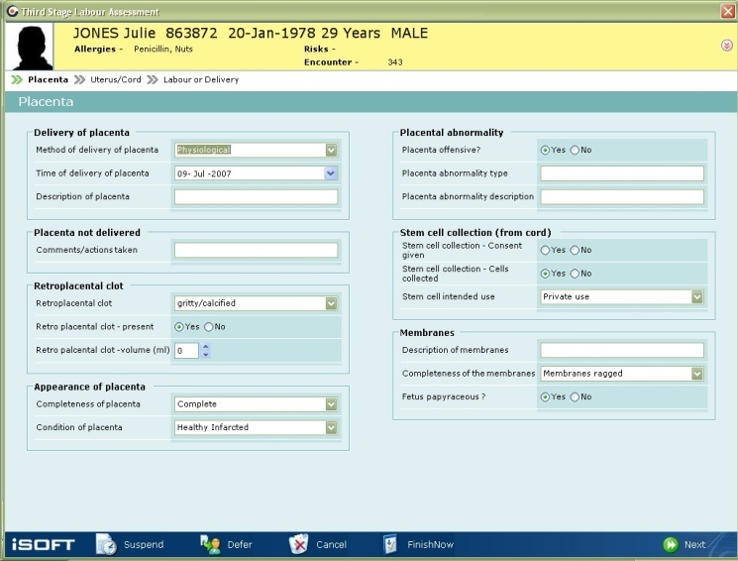
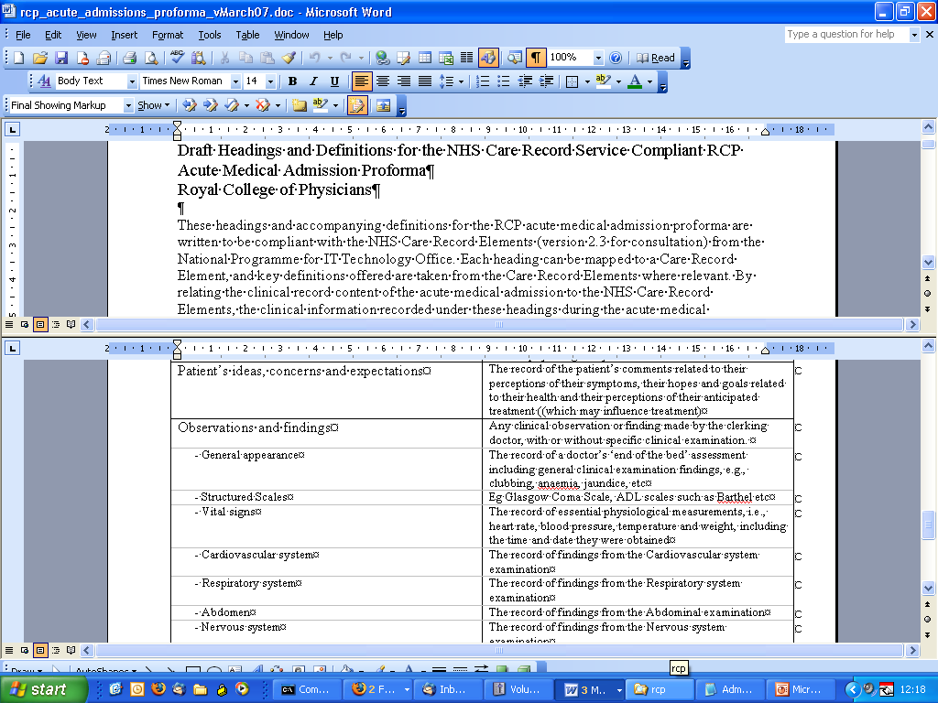
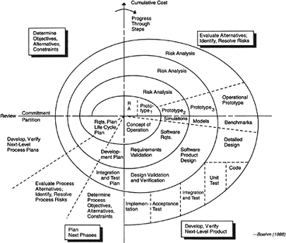
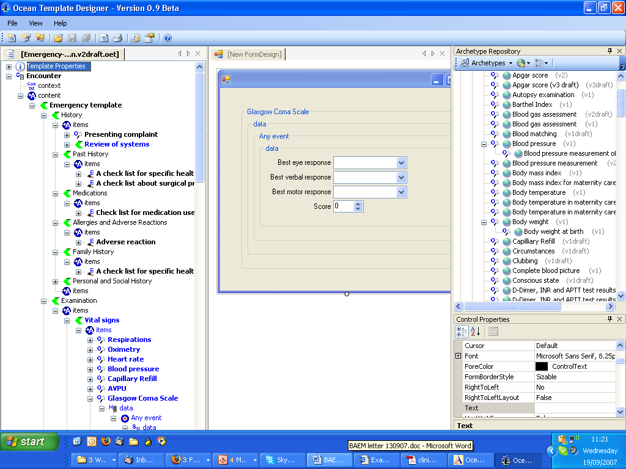
Test Requirement
Build Design
Generic Medical Documentation

Slide 40



Slide 41


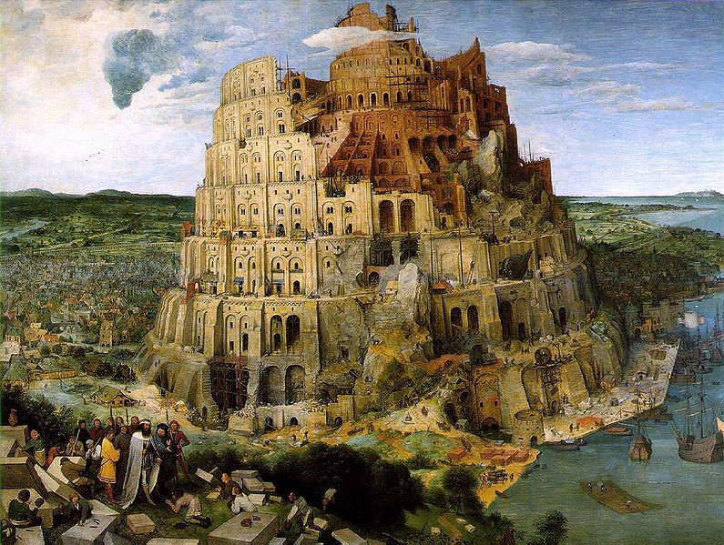

Slide 42

NHS Connecting for Health

Slide 43


Change: An ecosystem view..
International Standards
National eHealth Bodies
& Vendors
Regional
Local Frontline Innovators
Notes:
43

Slide 44
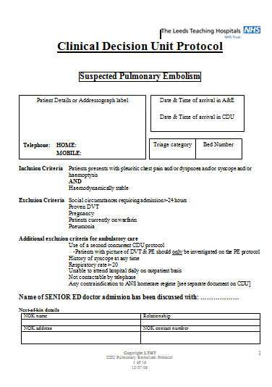
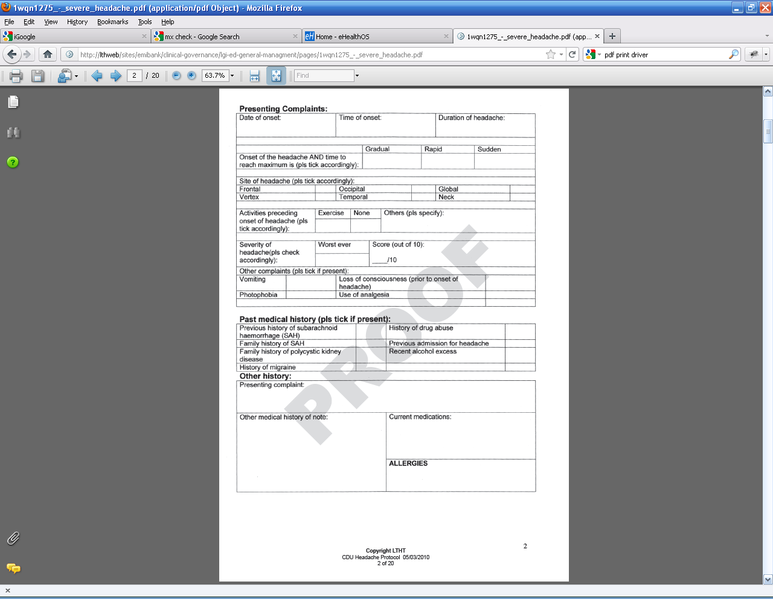
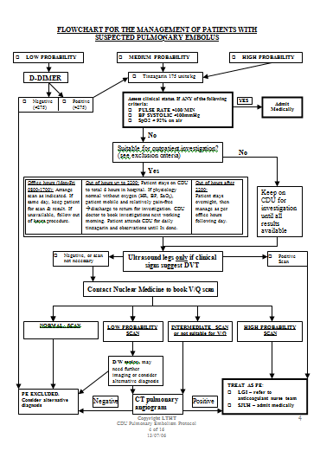
Step 1: Documentation/Guidelines: Paper

Slide 45


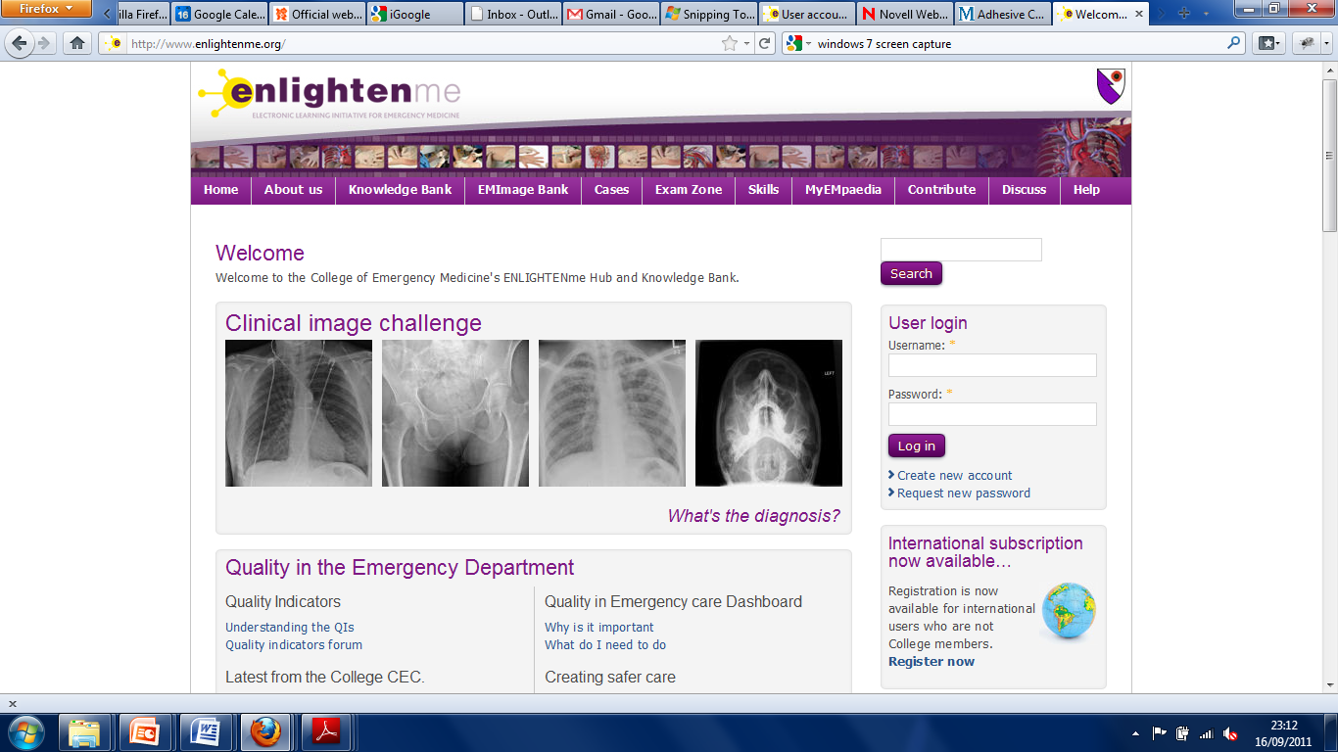
Step 2: Documentation/Guidelines : IT
Notes:
And so……..Our handheld solution also allowed for doctors to prescribe with the handheld at the bedside
I should add that the beauty of basing a solution like this on Inet technology is that you can harness so many other resources.
Here it allowed for doctors to click a link to the internet for uptodate drug formulary information

Slide 46
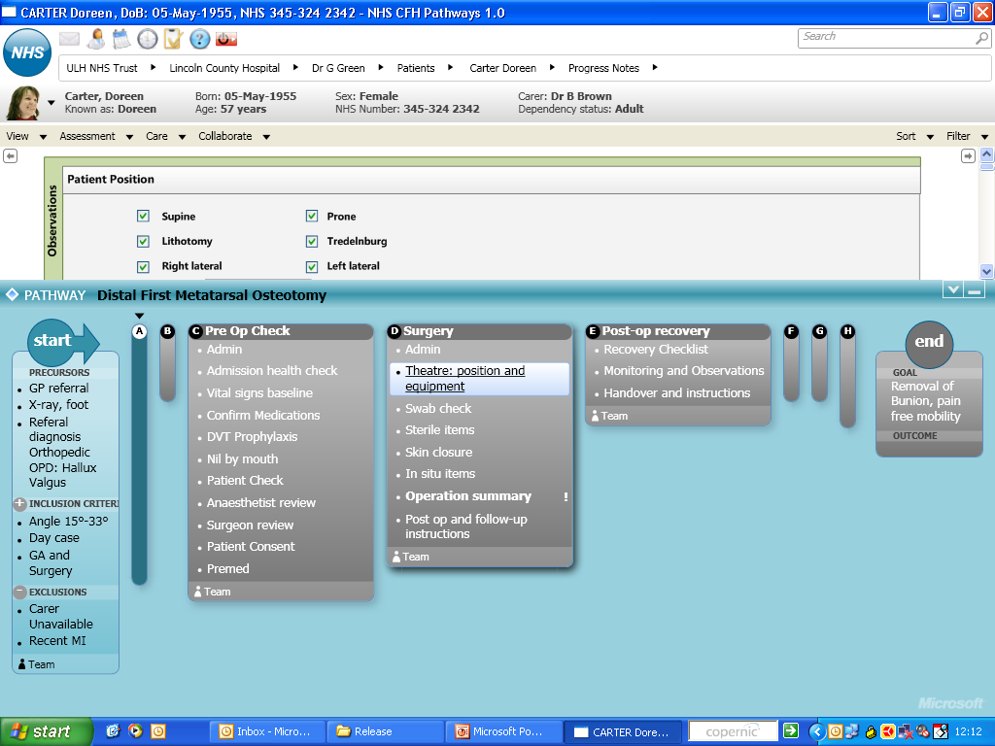
Step 3: Link Documentation + Guidelines
Notes:
Collapsed first steps of the pathway – now in actual surgery bottom section can be collapsed for clinician to document care given

Slide 47
Key points
EM is complex system
  very information intensive
Link Information & Knowledge Management
  Support our thinking
Guideline Based Workflow Integrated EHR
  Holy Grail of Informatics
Early Days in the Ecosystem
  Simple Steps for now

Slide 48

International EM Informatics network
Friday June 29, 2012 - 3:30pm to 5pm
Wicklow Meeting Room 5, Level 2 www.epijournal.com
tony.shannon@nhs.net
www.frectal.com

