Slide 1

Ecocem Room, Level 2
Data Management & Electronic Health in EM
Friday 29th June, 13:00 – 15:00
Tony Shannon (UK)
Current Challenges with a Paperless ED

Slide 2
Tony Shannon
M.B. B.Ch. B.A.O. Ireland
Fellow of College of Emergency Medicine England
Fellowship in Informatics USA
MSc in IT Management England
Consultant in Emergency Medicine, Leeds Teaching Hospitals
Chief Clinical Information Officer, Leeds Teaching Hospitals
(Clinical Lead, NHS Connecting for Health – National Programme for IT)
(Chair, Clinical Review Board, openEHR Foundation)
Notes:
2

Slide 3



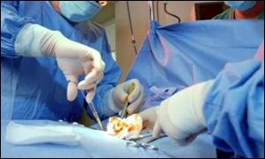


Slide 4
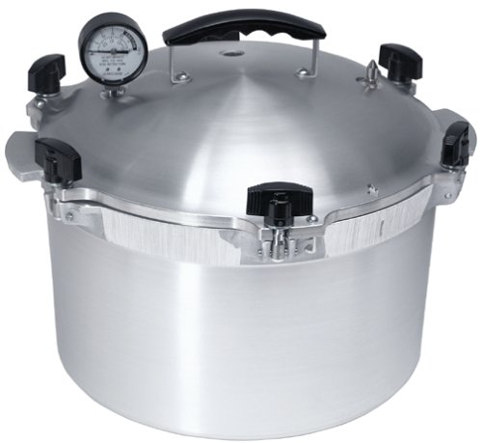





Slide 5
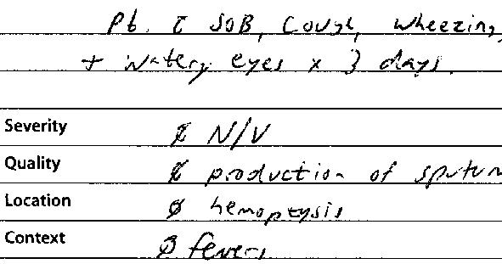


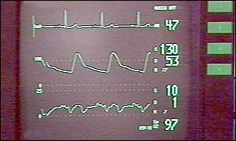
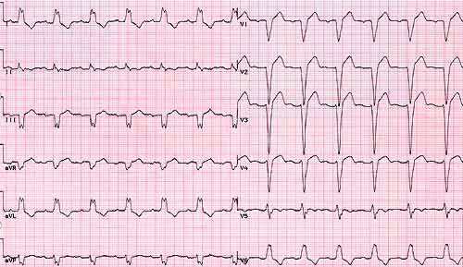
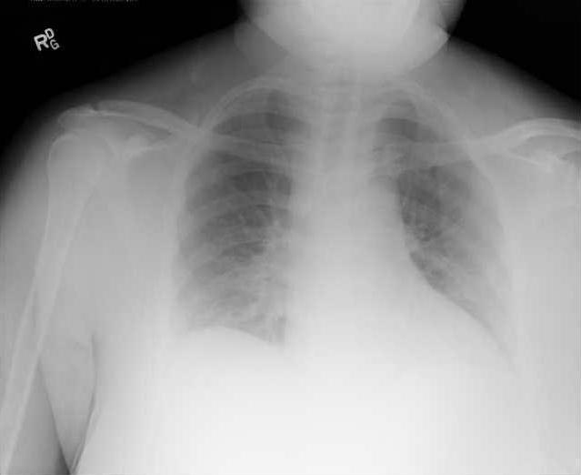
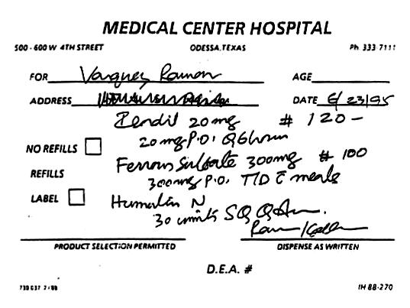
Notes:
Ladies and Gentlemen, Medicine is a tough business at times.
Part of what makes it so tough is the fact that every day and every hour of every day , every patient encounter involves dealing with a LOT of information.
Most doctors are very good at multitasking and processing information but there are many times when the volume of information we are trying to deal with can be overwhelming and can make it very hard to get to the right information at the right place and the right time

Slide 6


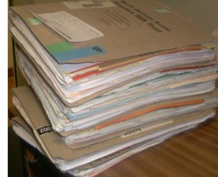

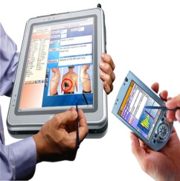
Key Elements of Emergency Medicine
Research (++ patients)
Doing the Right Thing
Doing Things Right
Right Care, Right Place, Right Time
Audit ( > 1 patient)
Frontline (1 patient)
Referral in
Assessment
Diagnostics
Deliver Care
Plan Care
Sorting
Referral Out

Slide 7


Info Tech..
Success not widespread….

Slide 8
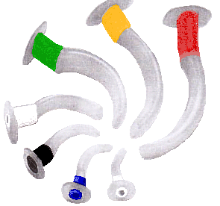
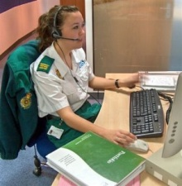
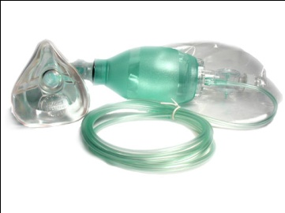

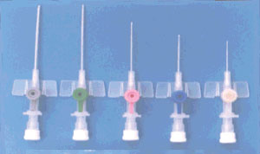
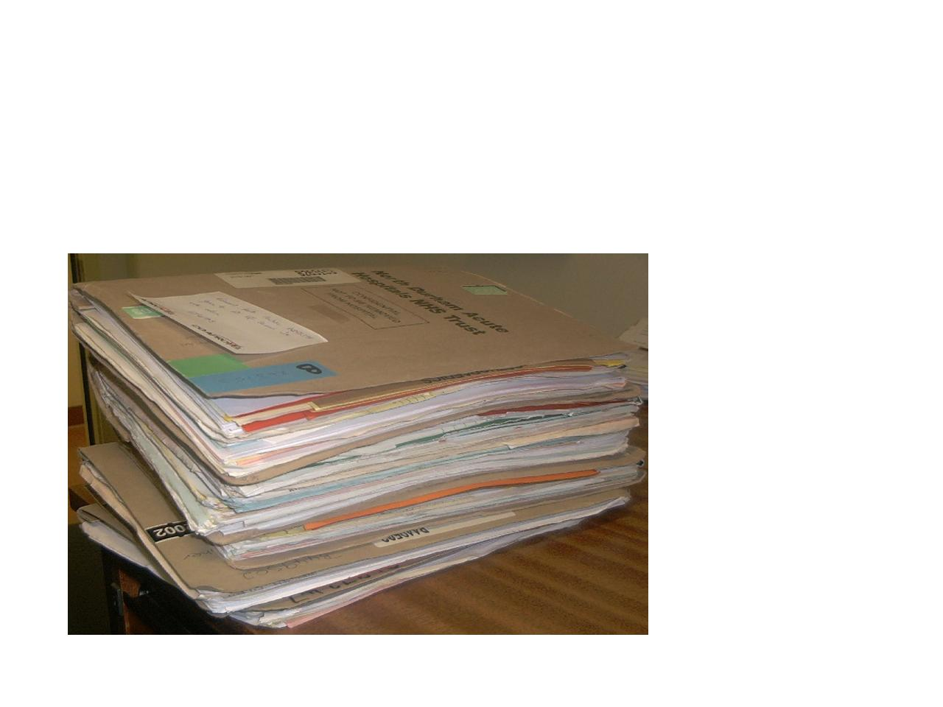
Emergency Medicine= Complex
Notes:
Ladies and Gentlemen, Medicine is a tough business at times.
Part of what makes it so tough is the fact that every day and every hour of every day , every patient encounter involves dealing with a LOT of information.
Most doctors are very good at multitasking and processing information but there are many times when the volume of information we are trying to deal with can be overwhelming and can make it very hard to get to the right information at the right place and the right time

Slide 9


eHealth: An Ecosystem View
International Standards
National eHealth Bodies
& Vendors
Regional
Local Frontline Innovators
Notes:
9

Slide 10

The Paperless ED
1.5% of 3,000 US hospitals
comprehensive e-records (2009)

Slide 11
The Paperless Challenge
Hospital
Department
Patient

Slide 12
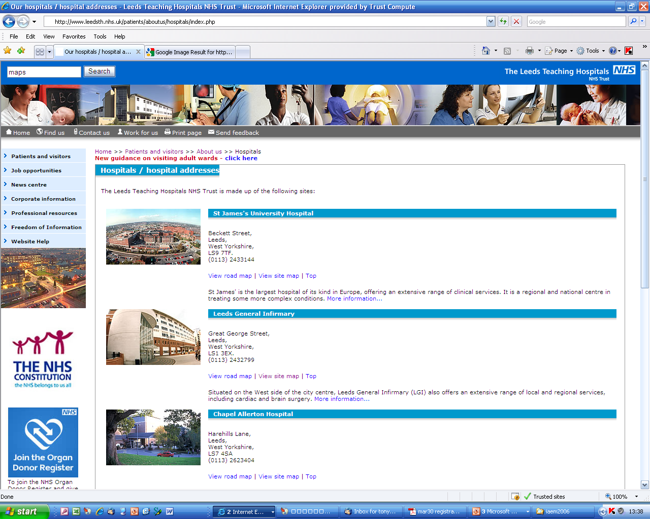

Leeds, England
6 Hospital Trust
14,000+ staff
>2000 Beds
>200 IT systems

Slide 13
Hospital: ABC of Technical Options
Portal
E
D
I
S
PAS
1
2
3
4
5
Clinical Docs
Vendor X
Orders Results
ePrescribing
IE
Scheduling
200+
Primary Care
A
B
C
Notes:
13

Slide 14
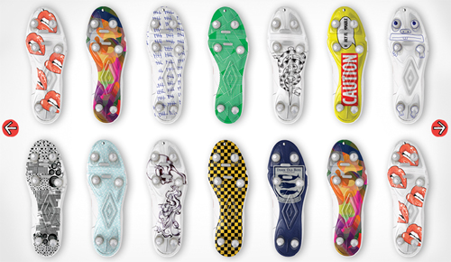

Slide 15
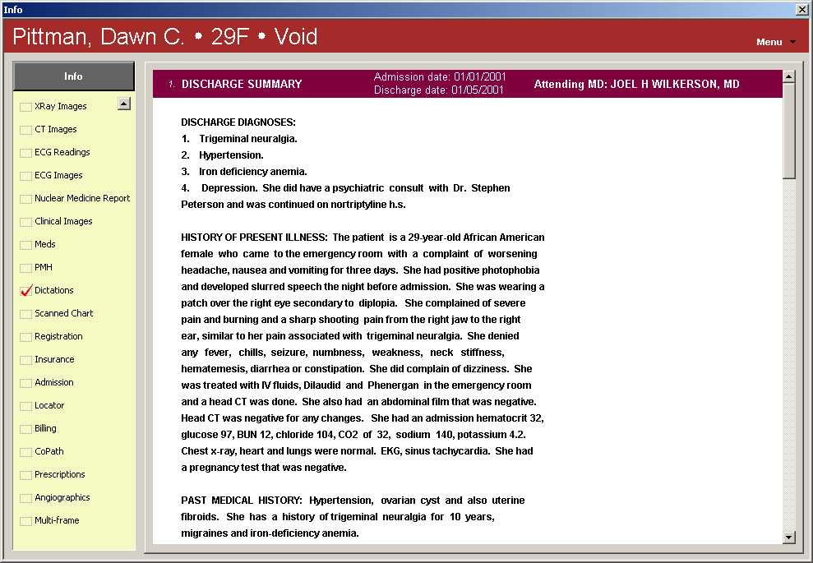
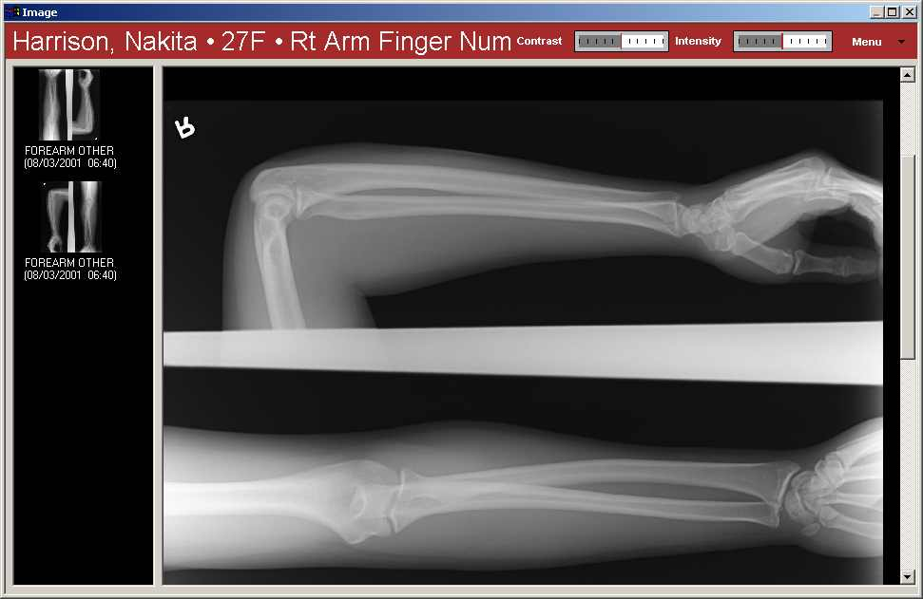
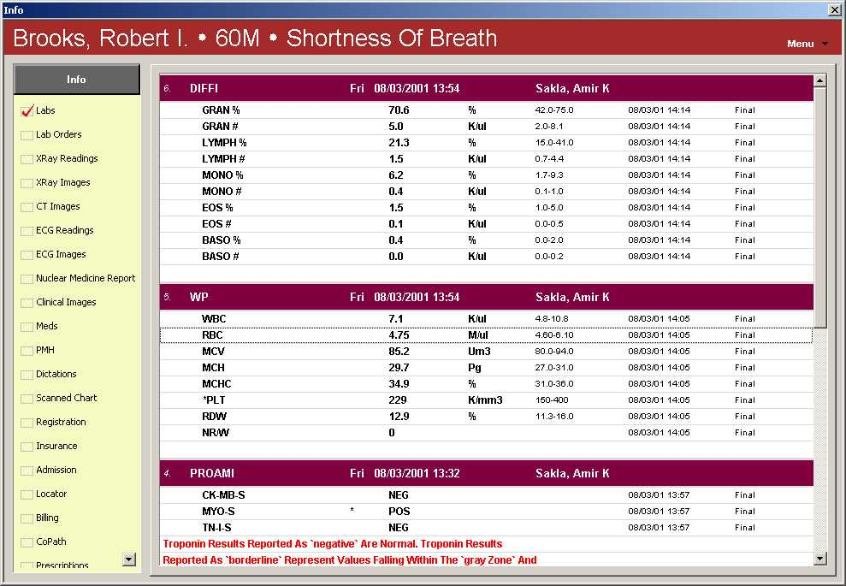
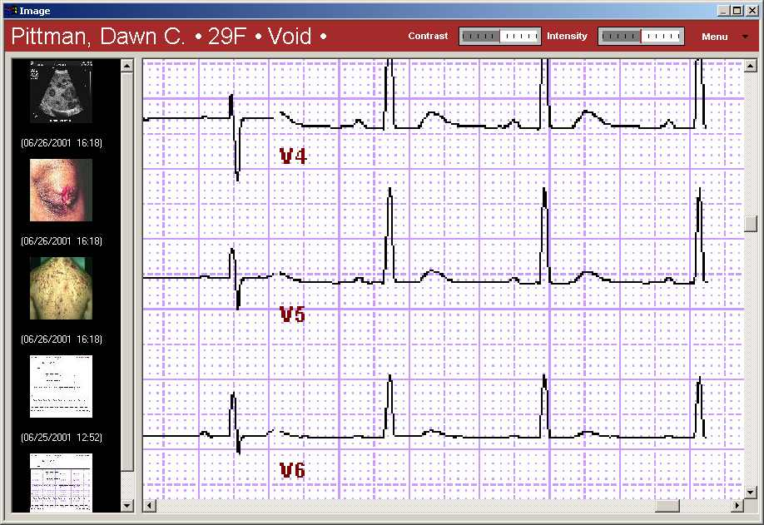

Slide 16
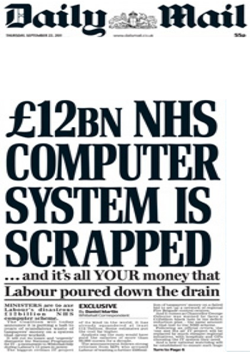

NHS Connecting for Health

Slide 17
Leeds, England
2 Emergency Departments
  110,000 patients/year
  90,000 patients/year
95% 4-hour standard
  Arrival to Departure

Slide 18
ED: Process related IT needs
Patient Tracking
Registration
Assessment- Nursing
Assessment-Medical
Investigations
Diagnoses
Treatments
Referrals

Slide 19
Patient Tracking
 | Process A | Process B | Process C | Process D
Patient 1
Patient 2
Patient 3
Patient 4

Slide 20
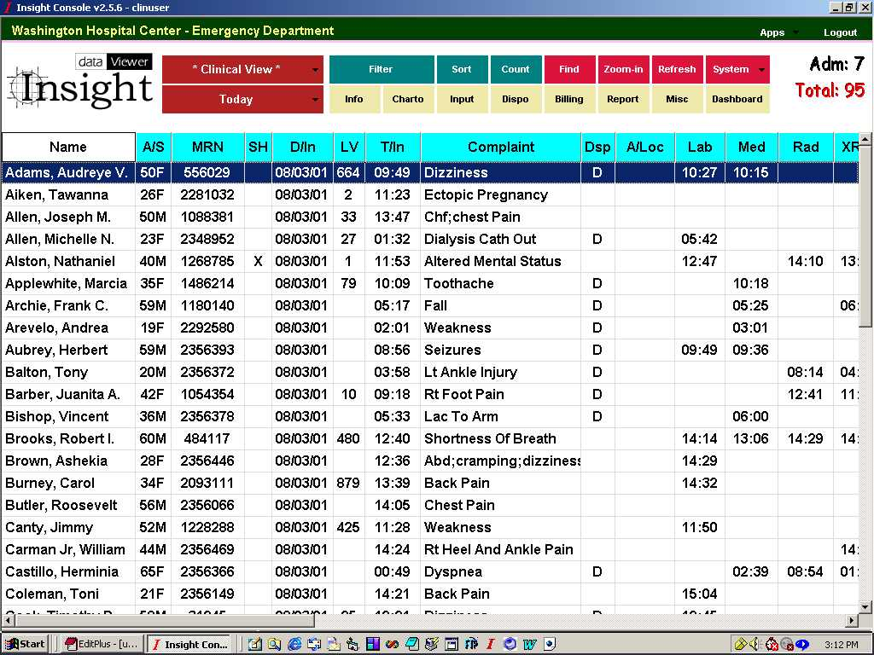

Slide 21
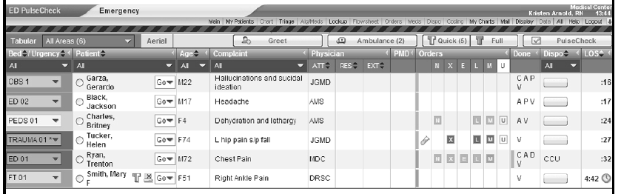
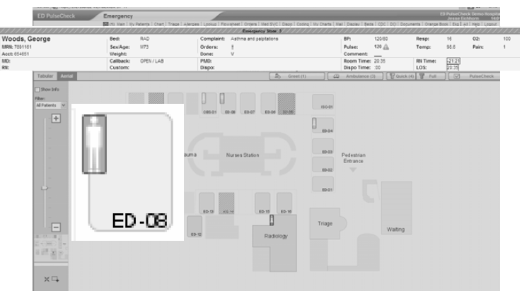

Slide 22
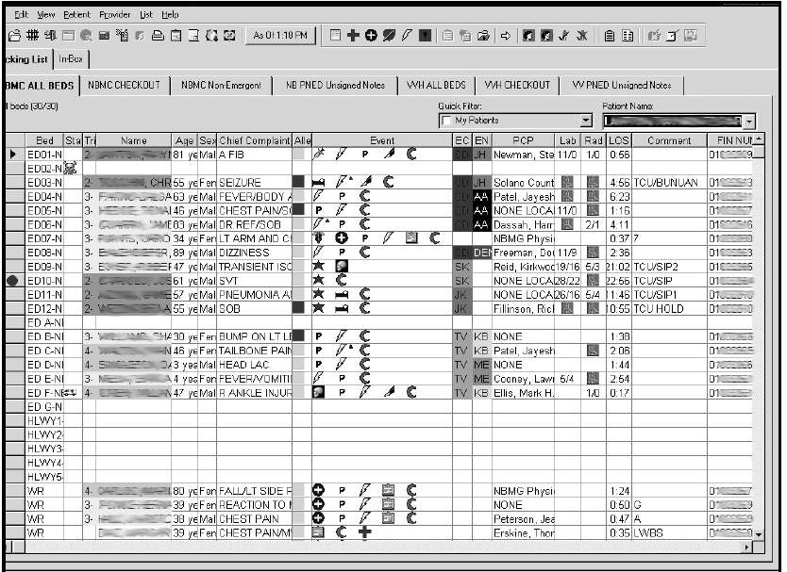
Cerner

Slide 23
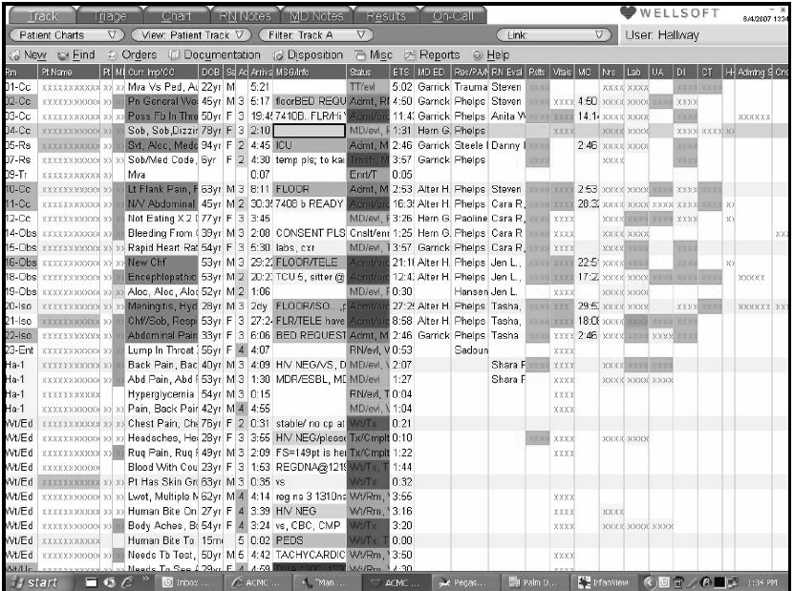

Slide 24
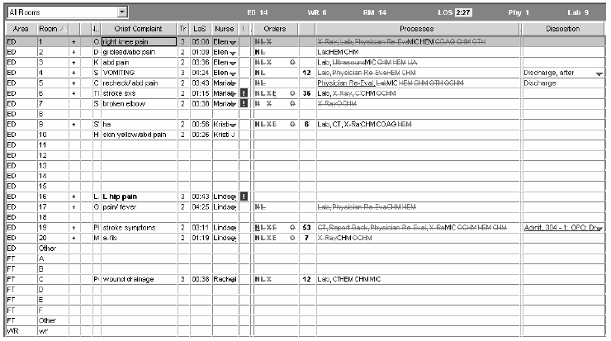
T system

Slide 25
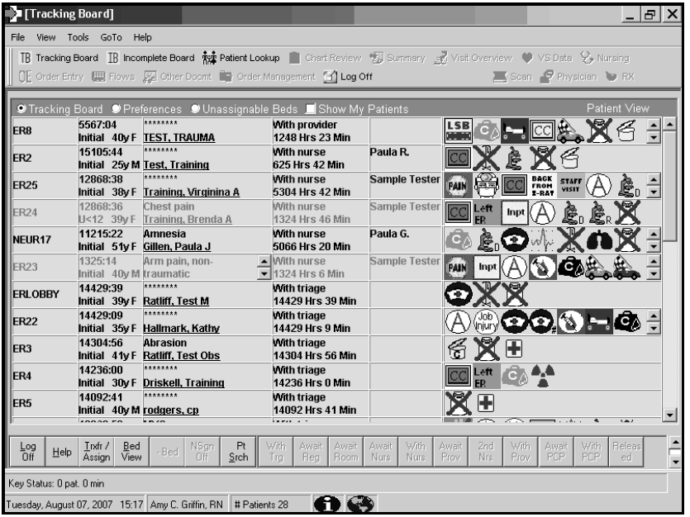
Allscripts

Slide 26
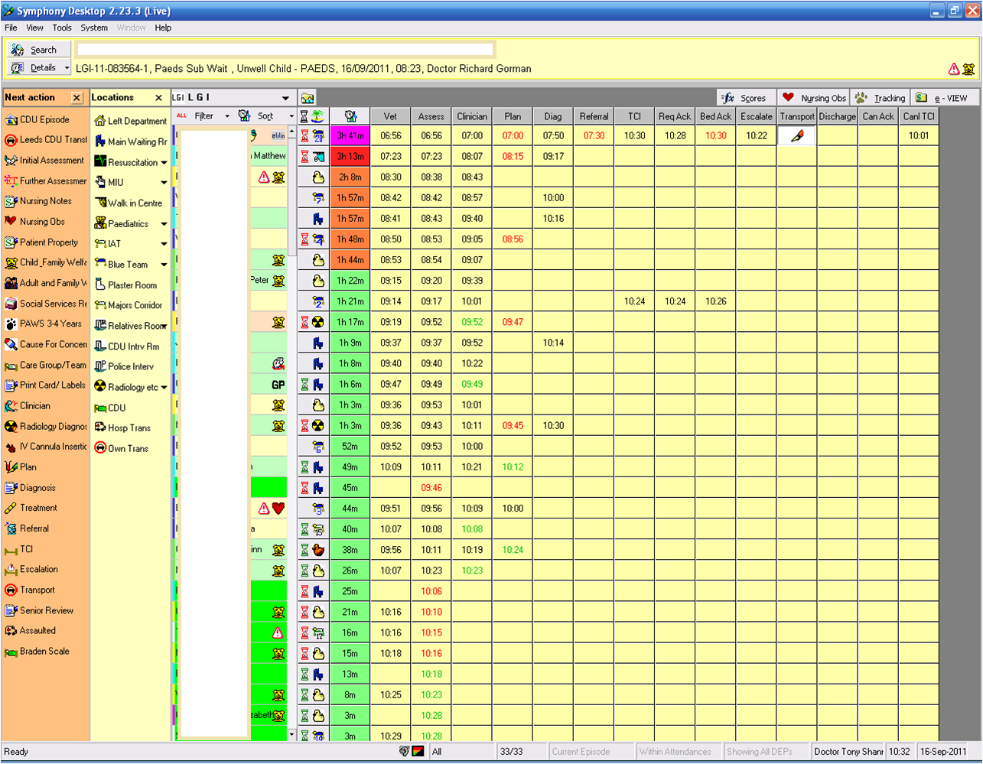

Slide 27
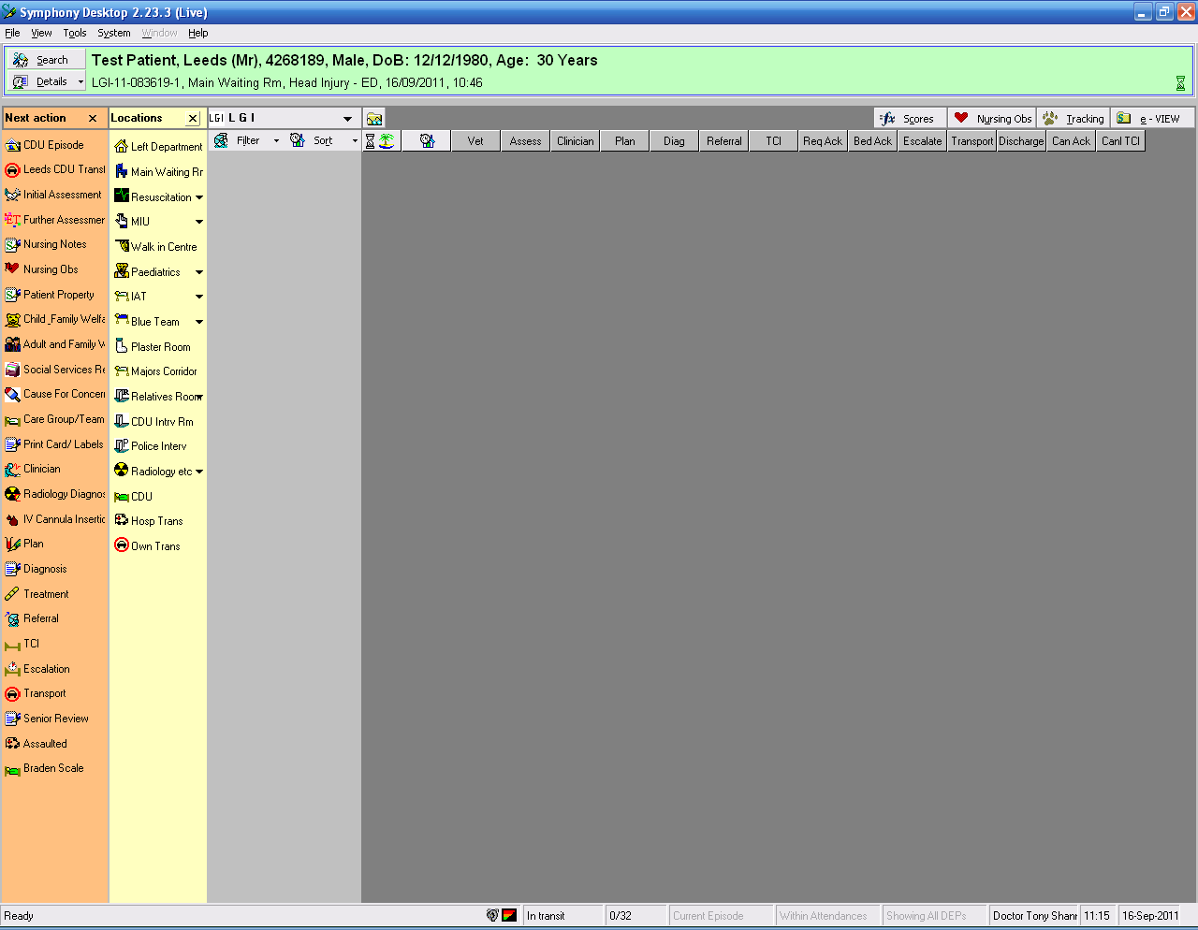
Registration

Slide 28
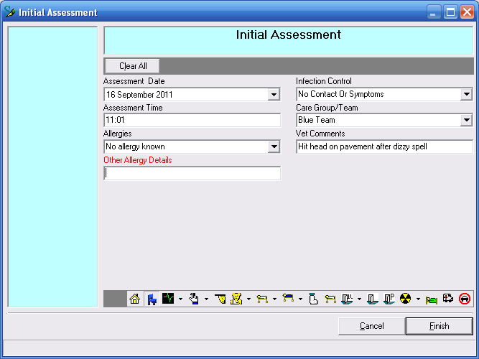
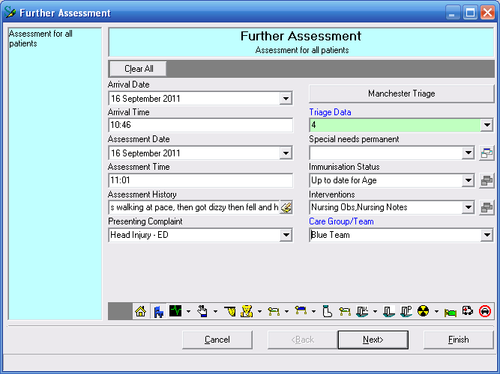
Assessment- Nursing

Slide 29

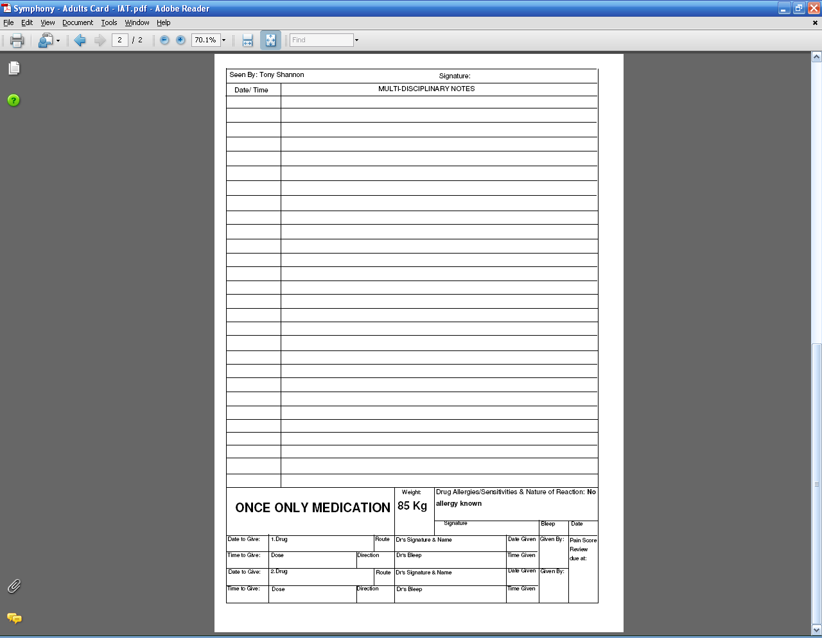
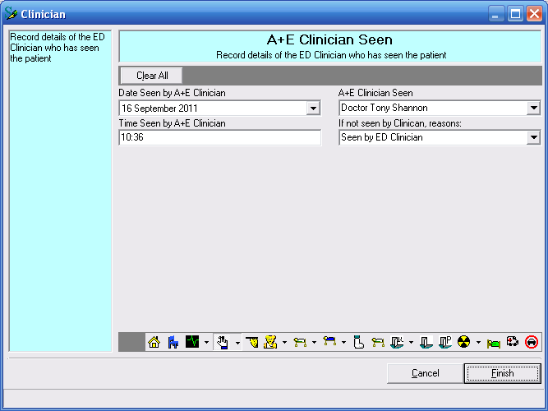
Assessment- Medical

Slide 30
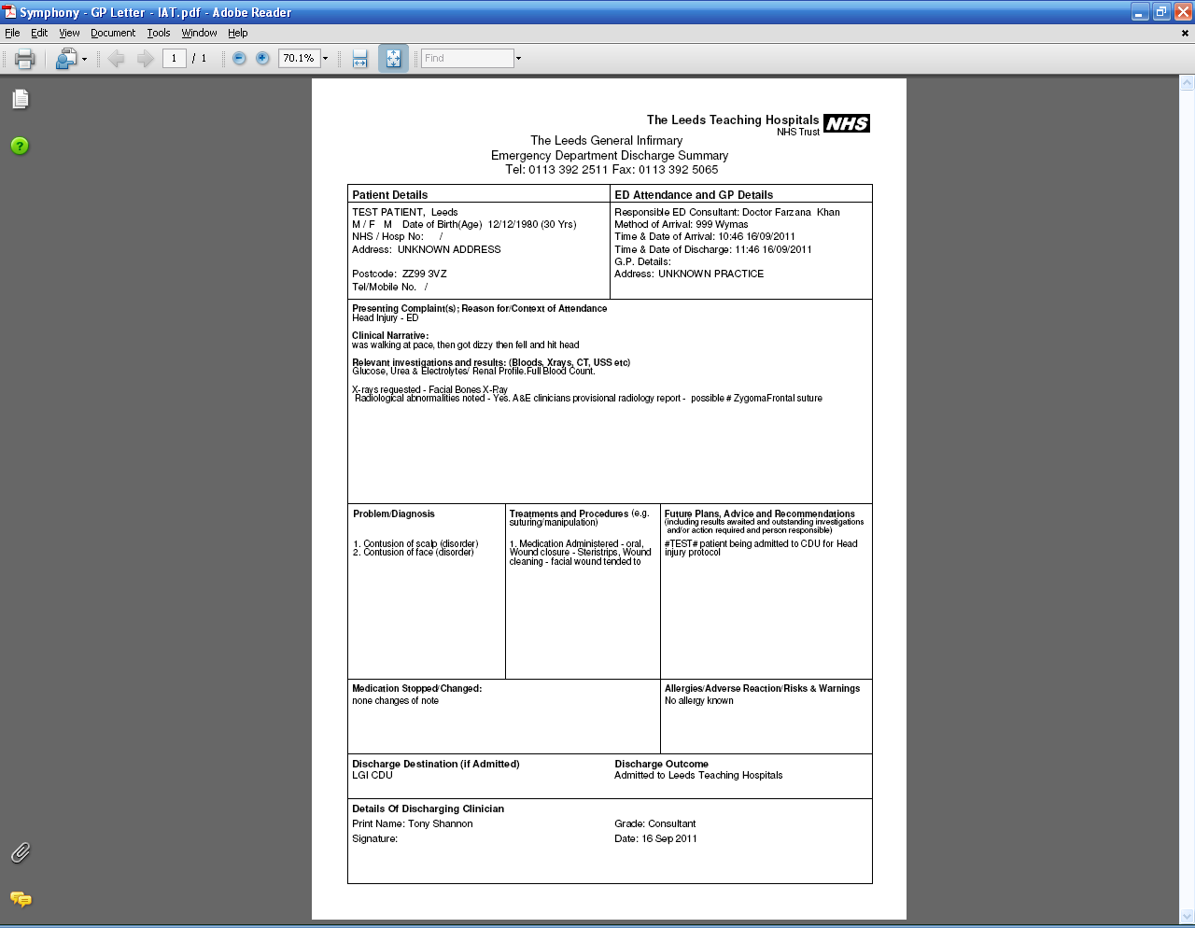
Discharge Summary

Slide 31
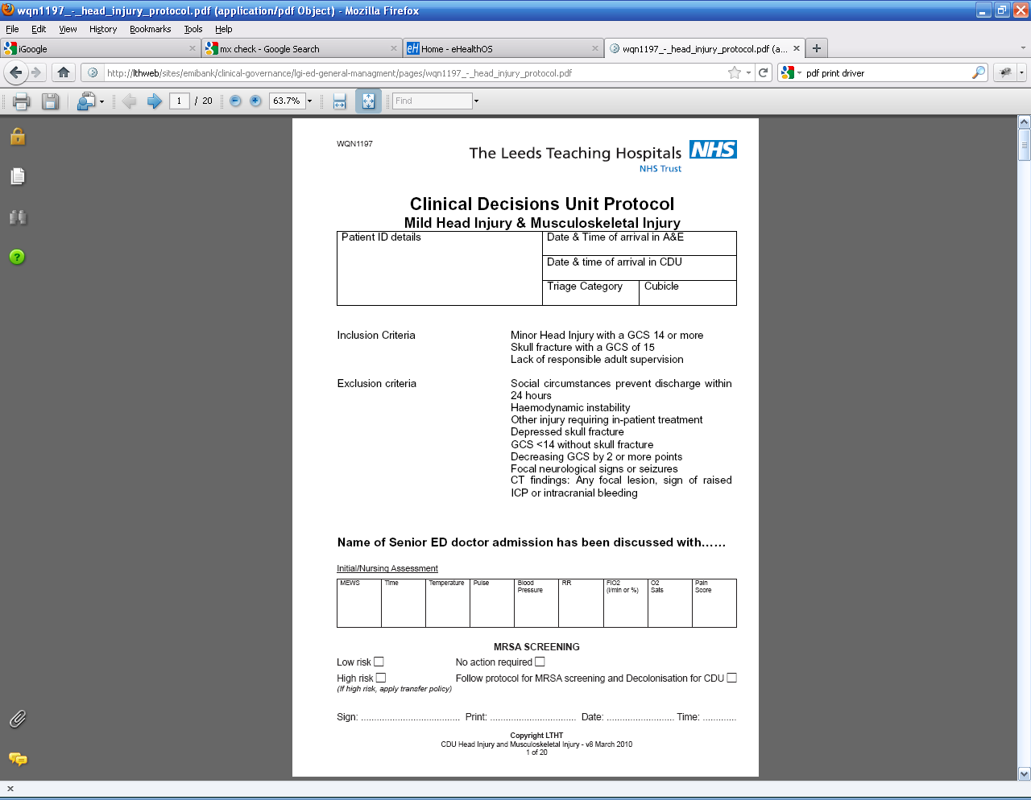
Transfer to CDU

Slide 32
Integrating Care: The Challenge
3x2=6
4x3=12
5X4= 20
11x10= 110
110x100= 11000
(Reeds Law)
1
2
3
4
5
Vendor X
200+
Notes:
32

Slide 33
ED- Process related IT needs
Patient Tracking | Electronic
Registration | Electronic
Assessment- Nursing | Electronic
Assessment-Medical | Paper
Investigations | Electronic
Diagnoses | Electronic
Treatments | Electronic & Paper
Discharges | Paper
Integration | Poor

Slide 34
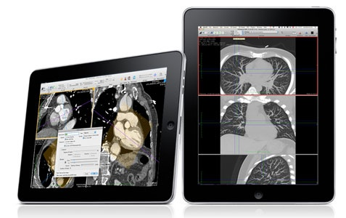
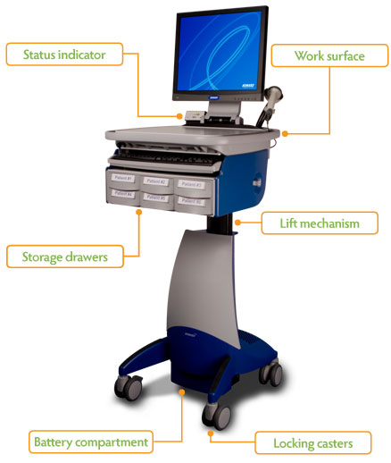
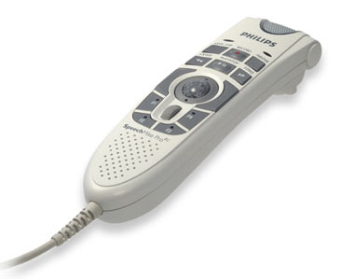
Hardware

Slide 35
Patient Stories: Structure + Narrative
Vomiting; RR 25, HR 110, GCS 13/15, pH 7.2, Glu 35
Mixed overdose (inc Paracetamol) staggered; over 7 hours ago; INR 4.5
I was sitting in the car with my partner arguing, things were getting too much, so I squashed my sandwich into my face in frustration

Slide 36
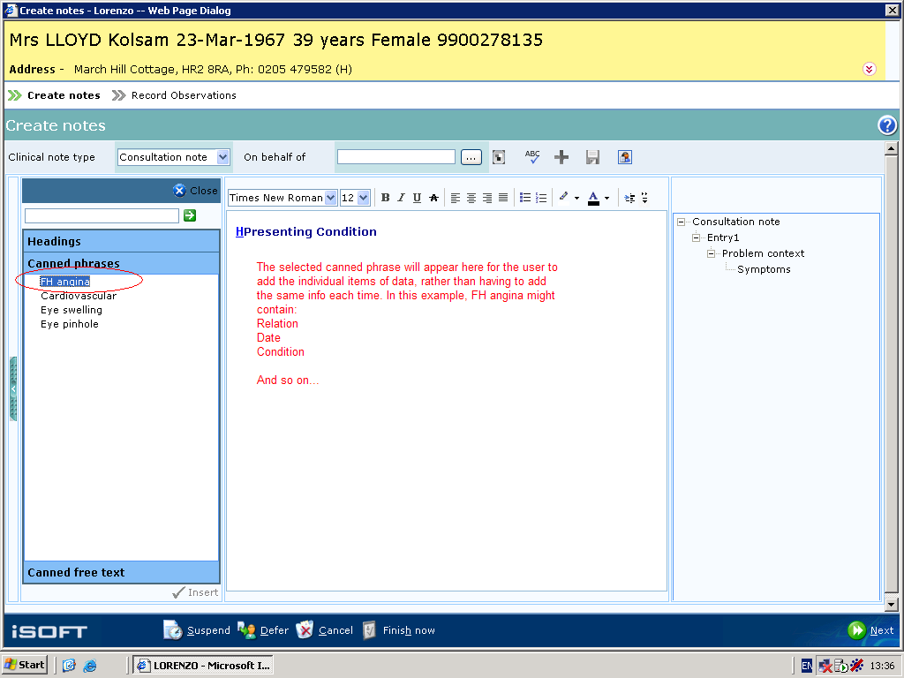

Slide 37
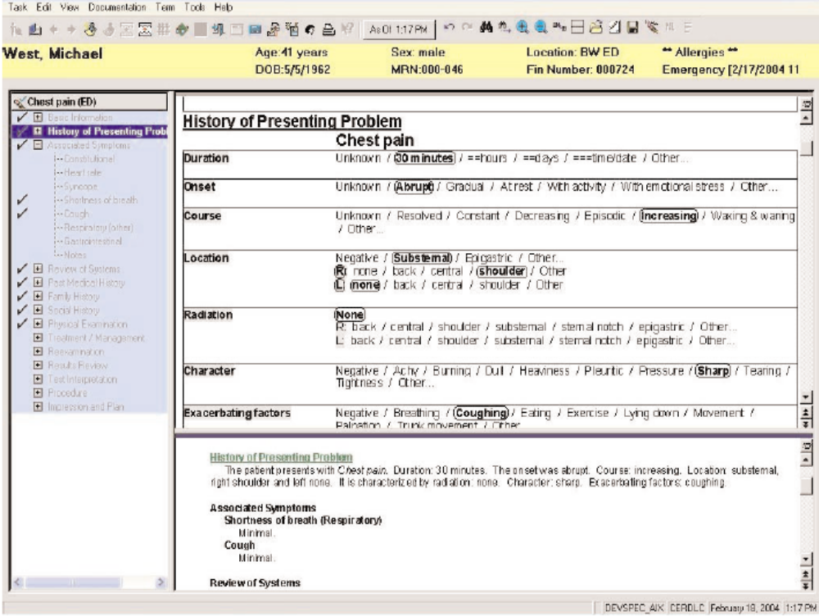

Slide 38
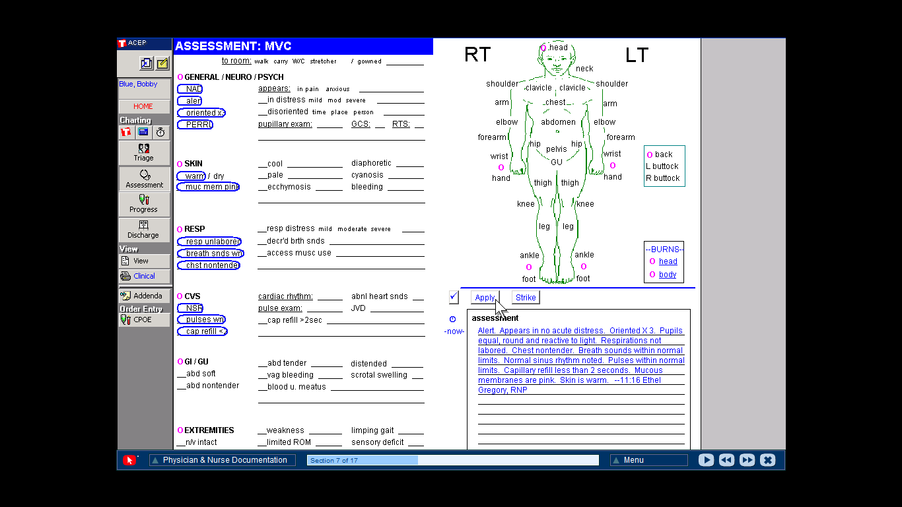

Slide 39
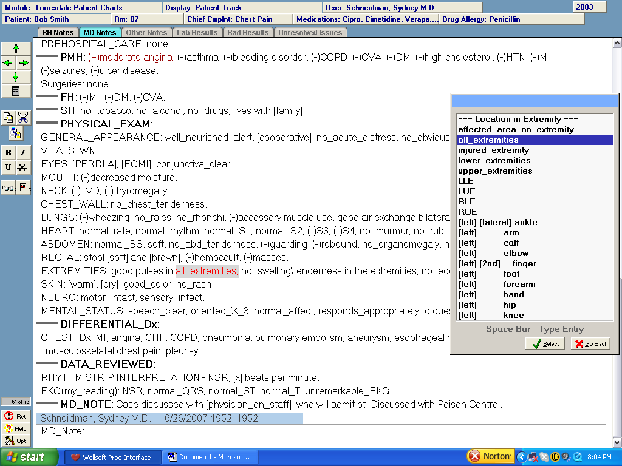

Slide 40


Slide 42

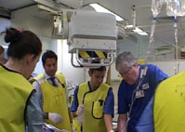

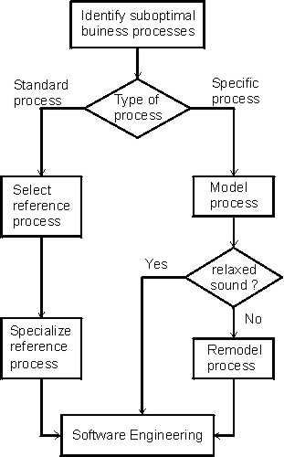

Value = Quality ⁭
Risk↓ Cost↓ Time↓
Notes:
42
When we examine the literature on business change my view is that 3 common elements exist within any business,
The people, the processes, the technology
OF these the BP is the key focus when managing change
Of note it is well established that BP change should be supported by IT

Slide 43

Informatics Strategy
CUI Clinical Portal
PAS
1
2
3
4
5
Scheduling
System X
Orders Results
ePrescribing
TIE
Clinical Docs
200+
Primary Care
A
B
C
Notes:
43

Slide 44

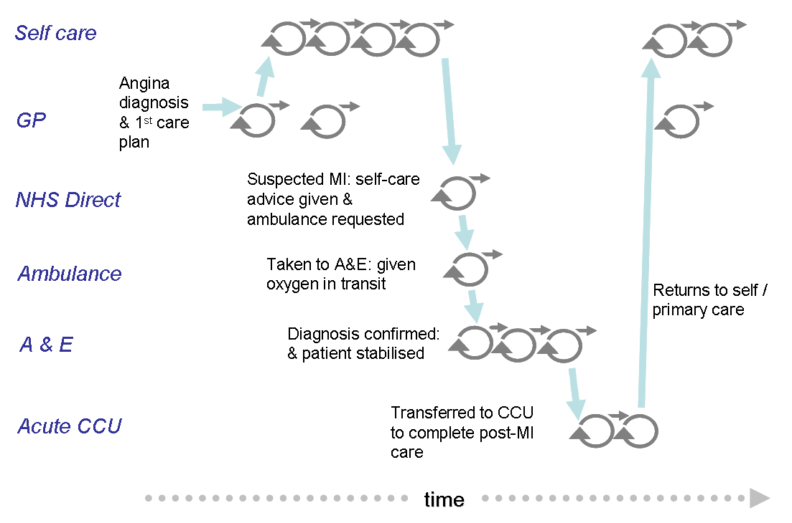


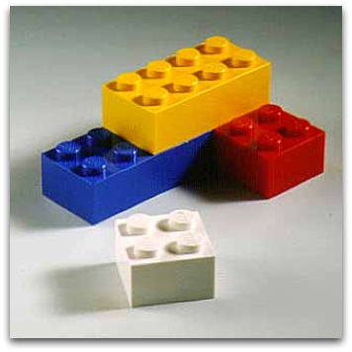


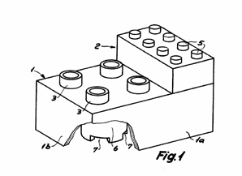
Specific Patient Journeys IT Library
Generic Generic Process IT Bricks

Slide 45
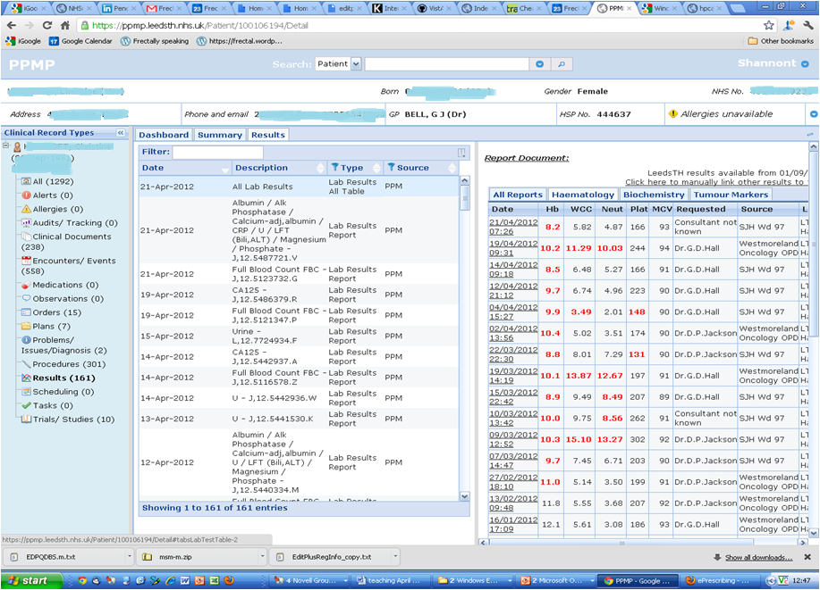
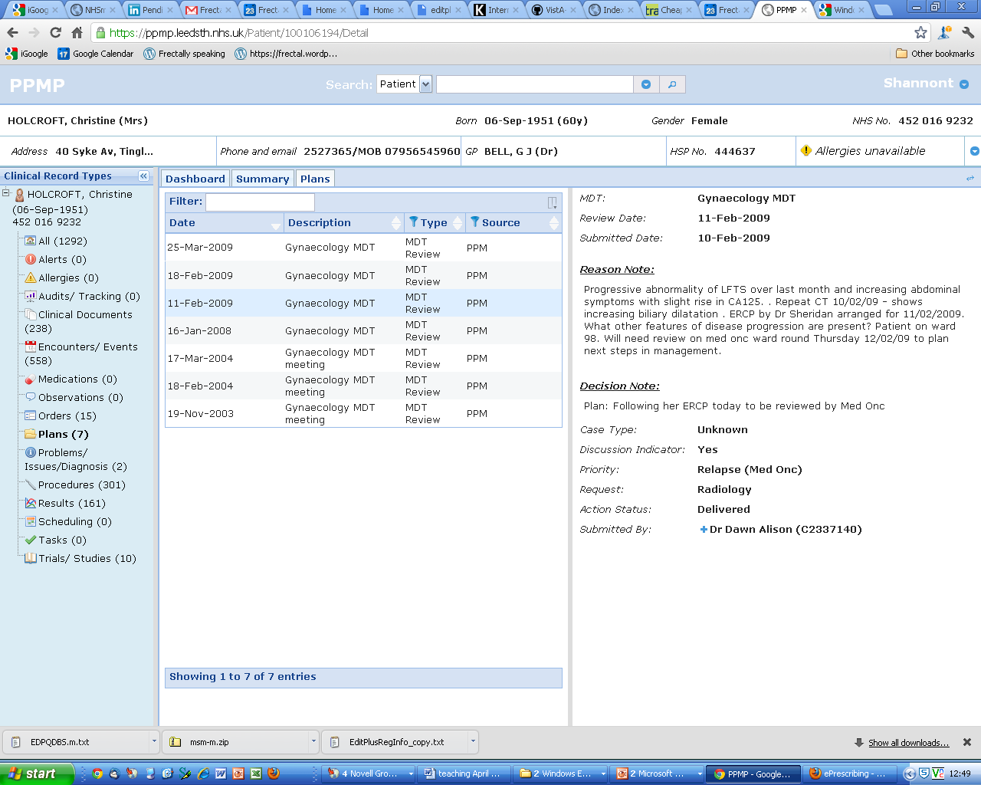

Clinical Portal: Patient Oriented & User Centred

Slide 46



eHealth ecosystem….
International Standards
National eHealth Bodies
& Vendors
Regional
Local Frontline Innovators
Notes:
46

Slide 48
Key points
EM is Complex System
  V. few paperless
People
  Needs Clinical Leadership
Process
  Iterative Improvement
Technology
  Integration & Usability is Key
Early Days in Ecosystem

Slide 49

International EM Informatics network
Friday June 29, 2012 - 3:30pm to 5pm
Wicklow Meeting Room 5, Level 2 www.epijournal.com
tony.shannon@nhs.net
www.frectal.com

